Slide 1
Introduction to Artificial Intelligence (AI)
Understanding the Basics of Intelligent Systems

Slide 2
What is Artificial Intelligence?
AI is the branch of computer science that aims to create machines that can mimic human intelligence.
It involves programming computers to process data, learn from experience, and make decisions.
Goal: Develop systems that can perceive, reason, learn, and act.

Slide 3
Brief History of AI
1950: Alan Turing proposes the Turing Test
1956: Term "Artificial Intelligence" coined at Dartmouth Conference
1960s-70s: Early AI programs (e.g., ELIZA)
1980s: Rise of expert systems
2000s-Present: Deep learning, robotics, and real-world applications

Slide 4
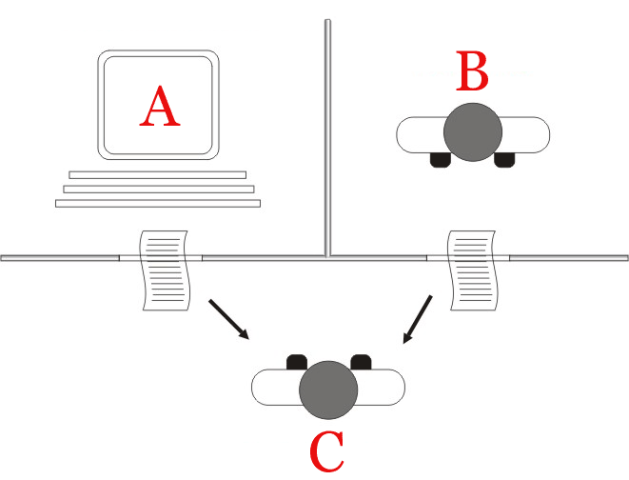
Turing Test
The Turing test refers to a thought experiment developed in 1950 by Alan Turing, a way to gauge a machine’s ability to generate human-like communication. Originally called “the imitation game,” the Turing test is a useful tool for studying a machine’s interactions with humans and reflecting on the definitions of “thinking” and “intelligence.”

Slide 5
Turing test participants
A Turing test has three participants:
A human judge (also called the interrogator) asks questions for a machine and a human to answer. The judge evaluates the responses from the machine and human to identify the responder.
A machine interlocutor, such as a generative AI system, answers the judge’s questions in natural language that simulates human conversation and behavior.
A human interlocutor who answers the judge’s questions alongside the machine and provides a baseline for comparison against the machine.

Slide 6
Types of AI
Narrow AI (ANI) – Weak AI:
Performs specific tasks (e.g., voice assistants)
General AI (AGI) – Strong AI:
Human-level intelligence (still theoretical)
Superintelligent AI - Future:
Beyond human capabilities (future concept)

Slide 7
Applications of AI
Voice Recognition (e.g., Siri, Alexa)
Image and Facial Recognition
Autonomous Vehicles
Healthcare Diagnosis
Financial Forecasting
Smart Assistants and Chatbots

Slide 8
Components of AI Systems
Learning: Acquiring knowledge from data
Reasoning: Drawing conclusions
Problem-Solving: Finding solutions to tasks
Perception: Understanding input (e.g., vision, sound)
Language Understanding: Processing human language

Slide 9
Searches in information System (IS)
information system, an integrated set of components for collecting, storing, and processing data and for providing information, knowledge, and digital products.
Examples:
1 - Transaction Processing System (TPS)
ATM systems, Point of Sale (POS) systems in retail, Online booking systems
2 - Management Information System (MIS)
Sales and inventory report system, HR management dashboards, Financial reporting systems
3 - E-commerce Systems
Amazon, Shopify, WooCommerce

Slide 10
Search Algorithms
In Artificial Intelligence (AI), searching algorithms are used to navigate through problem spaces (like mazes, puzzles, games, or decision trees) to find optimal solutions or paths.
Uninformed (Blind) Search Algorithms.
Informed (Heuristic) Search Algorithms

Slide 11
Uninformed (Blind) Search Algorithms.
These algorithms do not use any information about the goal other than how to generate successors.
Breadth-First Search (BFS)
Depth-First Search (DFS)
Uniform Cost Search (UCS)
Depth-Limited Search
Iterative Deepening DFS (IDDFS)

Slide 12
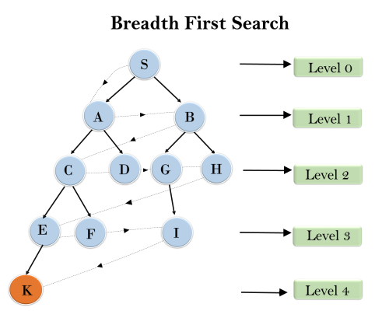
Breadth First Search (BFS)
S
AB
BCD
CDGH
DGHEF
GHEF
HEFI
EFI
FIK
IK
K

Slide 13
Depth First Search (DFS) Algorithm
Depth First Search (DFS) is a graph traversal algorithm that starts from a source node and explores as far as possible along each branch before backtracking.
Key Features:
Uses recursion or a stack
Explores depth before breadth
Can be used on graphs and trees

Slide 14
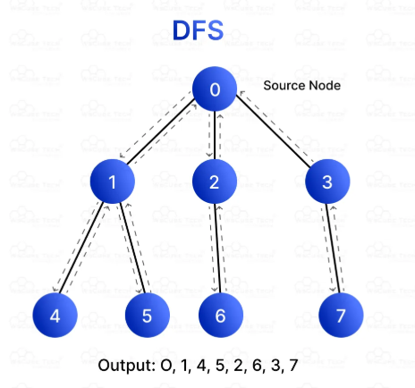
DFS Algorithm Steps
Start from the source node.
Visit and mark the node as visited.
Recur for all the adjacent nodes that are not yet visited.
Backtrack when no unvisited neighbors are left.

Slide 15
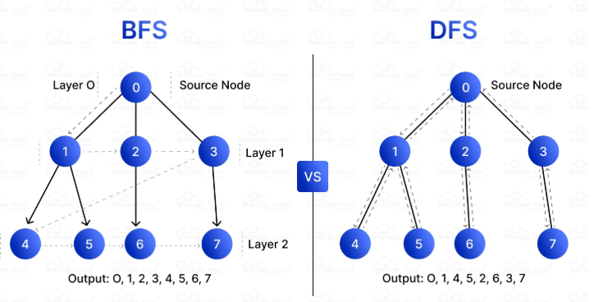
BFS Vs DFS

Slide 16
Depth-Limited Search (DLS)
Depth-Limited Search (DLS) is a variant of Depth First Search (DFS) that limits the depth of the recursion to a predetermined level. It helps avoid infinite loops in graphs with cycles or infinite depth.
Same as DFS, but with a depth limit.
If a node is at the depth limit, DLS stops exploring deeper from that node.
It is incomplete if the solution is beyond the depth limit.

Slide 17
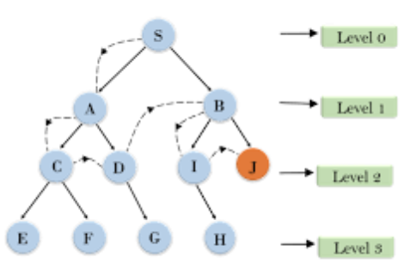
Depth-Limited Search (Example)
Depth = 2
Target = J

Slide 18
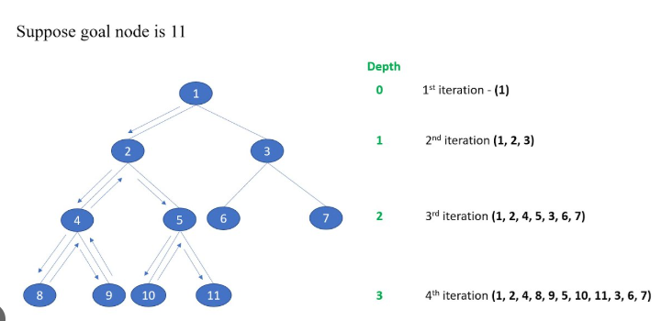
Iterative Deepening Depth First Search (IDDFS)
Iterative deepening depth-first search is a state space/graph search strategy in which a depth-limited version of depth-first search is run repeatedly with increasing depth limits until the goal is found.

Slide 19
Informed search strategies
Informed search strategies, also known as heuristic search, use extra knowledge about the problem to find solutions more efficiently than uninformed (blind) searches. They rely on a heuristic function (h(n)) to estimate the cost from the current node to the goal.
Greedy Best-First Search
A* Search

Slide 20
How Greedy Best-First Search Works?
Greedy Best-First Search works by evaluating the cost of each possible path and then expanding the path with the lowest cost. This process is repeated until the goal is reached.
The algorithm uses a heuristic function to determine which path is the most promising.
The heuristic function takes into account the cost of the current path and the estimated cost of the remaining paths.
If the cost of the current path is lower than the estimated cost of the remaining paths, then the current path is chosen. This process is repeated until the goal is reached.

Slide 21
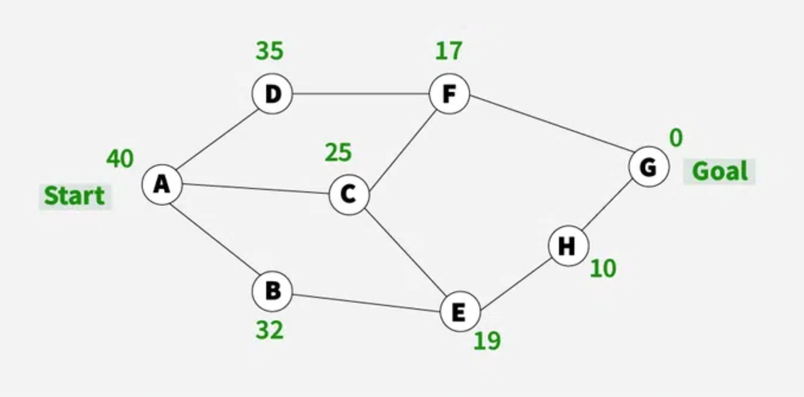
Heuristic function - h(n)
f(B) = h(B) = 32
f(C) = h(C) = 25
f(35) = h(35) = 32
f(F) = h(F) = 17
f(E) = h(E) = 19
f(G) = h(G) = 0
f(D) = h(D) = 35
A->C->F->G

Slide 22
Applications of GBFS
GPS Navigation Systems.
Example: A car navigation system estimating the shortest route to a destination.
Robot Motion Planning.
Example: A cleaning robot navigating a home.

Slide 23
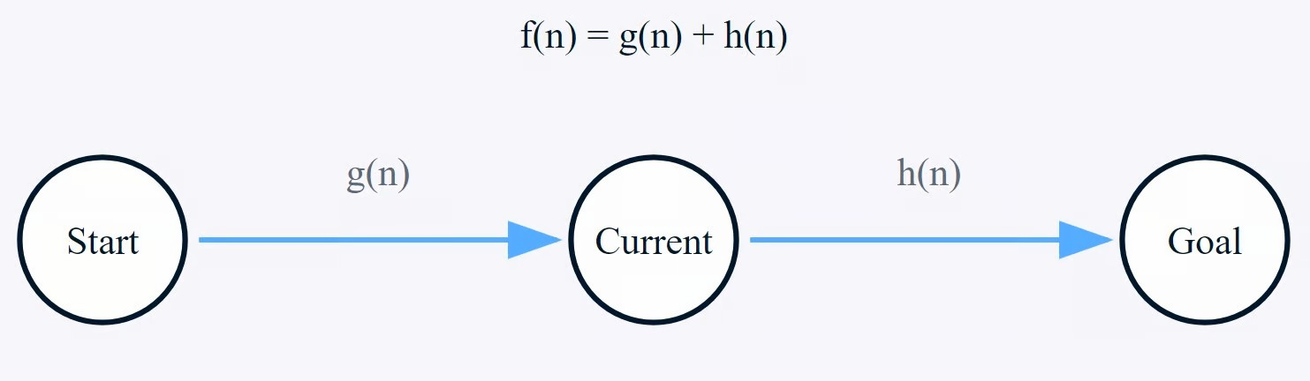
A* Search
A* Search algorithm is one of the best and popular technique used in path-finding and graph traversals.
This algorithm evaluates nodes by using following function
f(n) = g(n)+h(n)
g(n) = cost from initial state to current node (n)
h(n) = estimated cost from node n to the goal state.

Slide 24
How does A* Search work?
Heuristics h(n)
A | 5
B | 6
C | 4
D | 3
E | 3
F | 3
G | 0
B
3
1
D
2
A
2
F
4
4
1
C
5
3
E
G

Slide 25
Steps
A
f(B) = g(B)+h(B)
= 1+6 = 7
B
C
f(C) = g(C)+h(C)
= 4+4 = 8
A | 5
B | 6
C | 4
D | 3
E | 3
F | 3
G | 0
B
3
1
D
2
A
A
F
2
4
4
B
C
1
C
5
E
3
G
f(C) = g(C)+h(C)
= 3+4 = 7
C
D
f(D) = g(D)+h(D)
= 4+3 = 7
Complete this…

